Slide 1



MEASI COLLEGE OF EDUCATION - 10209
Choolai, Chennai - 600112
Affiliated to Tamil Nadu Teachers Education University.
ASSESSMENT FOR LEARNING
Presented by
Mrs. R. LATHA
Assistant Professor in Computer Science
Notes:
This template is provided by http://www.free-power-point-templates.com/

Slide 2
Summarization and Interpretation of Results,
Reporting of Assessment Findings.
Unit – I - Basics of Assessment

Slide 3
Principle Related to Different Stages of an Assessment Programme.
Developing / Choosing / Selection of methods for Assessment
Collecting the Assessment Information
Judging and Scoring Student Performance
Summarization and Interpretation of Results
Reporting of Assessment Findings.

Slide 4


Sheela has just returned John’s Test Result
Test Result

Slide 5
Suppose John Received this
Score…
Score: 25

Slide 6

He can’t help but he may ask some questions like…

Slide 7
What does this score means?
Score: 25
?
Is this a high or a low score?
If I got this score, how did others do?
Is this score high or low enough with respect to what I can do?
Does this score mean I have improved?
What does this score mean in terms of what I cannot do?

Slide 8

Basically, we need a frame of reference to interpret the score

Slide 9
What are they?

Slide 10

FRAMES OF REFERENCE
We will consider four approaches to interpreting student performance

Slide 11
1. Ability - referenced
Student’s maximum possible performance
(Various Skills)

Slide 12
2. Growth - referenced
Student performance is compared with the student’s prior performance

Slide 13
3. Norm - referenced
Comparing the student’s performance with peer group

Slide 14
4. Criterion - referenced
What the student can and cannot do

Slide 15
Which of the
Four FRAMES OF REFERENCE
are the most useful?

Slide 16
Criterion – referenced
Norm – referenced
interpretations
The most useful references

Slide 17
Summarizing and Interpreting of Results
Methods of interpreting the results
1. Norm-referenced Interpretation
2. Criterion-referenced Interpretation

Slide 18
1. Norm-referenced Interpretation
Student’s performance or progress in relation to others of the same peer group, age or ability.
Ranking or Scaling.
To compare achievement in particular groups, subjects and years.

Slide 19
How to interpret norm-referenced tests
Ram’s score in the periodical exams is below the mean.
Sheela ranked 5th in the unit test in Physics.
John obtained the worst score in Mathematic exam
Sheeba won in the 200 meter running.

Slide 20
2. Criterion-referenced Interpretation
Student performance according to a specified domain or clearly defined learning tasks.
Vocational and Academic qualification.
Results are given on a pass/fail, competent / not competent basis.
Results are conclusive and usually open to
review.

Slide 21
How to interpret criterion-referenced tests
Helen can construct a pie graph with 75% accuracy
Heera scored 7 out of 10 in the spelling test
Riyan can encode an article with no more than 5 errors in spelling.
John can spell three difficult words in one minutes
Sheela can convert temperatures from Fahrenheit to Celsius.

Slide 22
When do we use the right Interpretation?
The type of evaluation often influences the reference used for the interpretation.

Slide 23
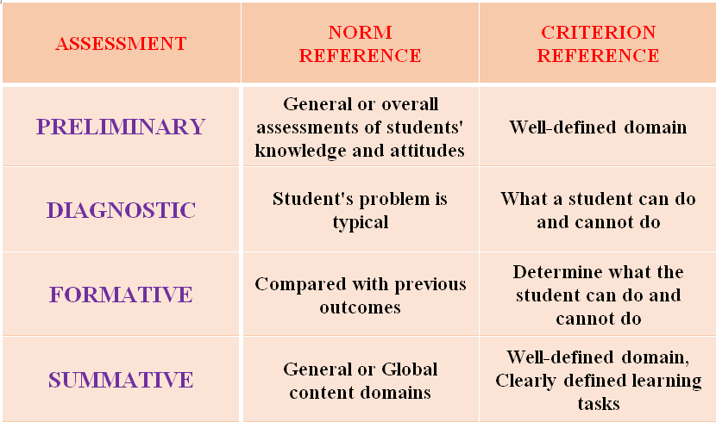
When do we use the right Interpretation?

Slide 24
PRINCIPLES
Written policy should guide the procedure
Individual results and grades should be explained in detail.
Carefully prepare Summary comments on student’s performance.
Student’s achievement, efforts, participation and other relevant behaviours should be assessed and graded separately in different scale of measurement.

Slide 25
Cont..
Marking the evaluation more reliable.
Proper weightage should be given for each of the assessment result.
Interpretation of assessment result should be justifiable.
Students background and their learning experiences are to be kept in mind.

Slide 26
REPORTING OF ASSESSMENT
FINDINGS

Slide 27
REPORTING OF ASSESSMENT FINDINGS
Assessment is an ongoing and integral part of the teaching and learning process.
The assessment result presented in the form of written report.
Through this process schools are able to provide easy-to-understand reports to parents about individual student learning outcomes.

Slide 28
Cont..
The type of assessment and report varies at different times during a student's school life.
Formal reporting to parents will occur at least once every semester.
Parents are encouraged to discuss their children's progress and needs with teachers at any time.

Slide 29
Purposes of Assessment Reports
Historical Record
Support for planning and decision
Making for improvements
Public relations
Document your contributions to the learning environment
To see how your efforts mattered

Slide 30
OVERVIEW OF GOOD PRACTICE IN COLLECTING AND USING ASSESSMENT INFORMATION
‘Assessment in education is the process of gathering, interpreting, recording and using information about students’ responses to an educational task’.
The assessment of student achievement is the basis of effective teaching and learning.

Slide 31
Cont..
‘Overall the purpose of assessment is to improve standards, not merely to measure them.’
Effective assessment systems help schools to monitor students’ progress and achievement, and enable them to design effective programmes.

Slide 32
Reporting
Reporting will contribute to communication and cooperation amongst teachers and parents.
Assessment report should contain accurate and complete information about student’s learning.

Slide 33
Reporting to Students
This can take the form of
  Discussion
  Written comments on works
  Identifying areas of strength and setting targets for areas needing to be worked on
  Encouraging any improvement
  Task well done ( * marks or sticker)

Slide 34
Reporting to Parents
Mostly, It is in the school policy to issue term exam written reports per year.
This will take the form of passed on record sheets, student reports and informal discussion among the teachers.
Reporting to Teachers

Slide 35
Reporting to School Board
The Head of the Teacher will provide information to the principal about overall attainment in the class.

Slide 36
ASSESSMENT SCHEDULE
Daily
Weekly
Monthly
Term-wise
At End of Topic or Session

Slide 37
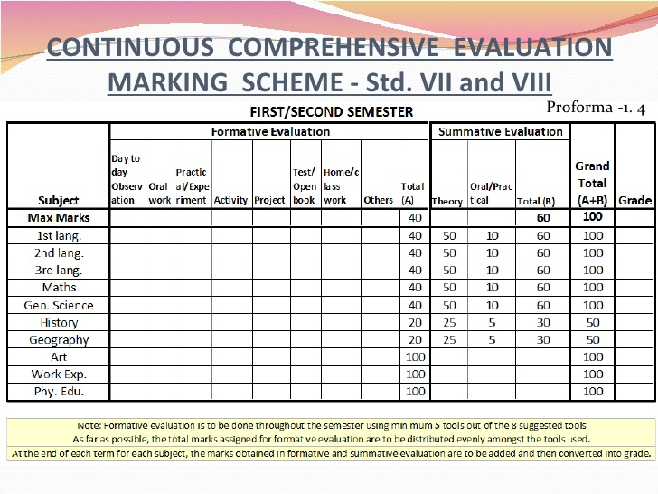
Individual Result

Slide 38
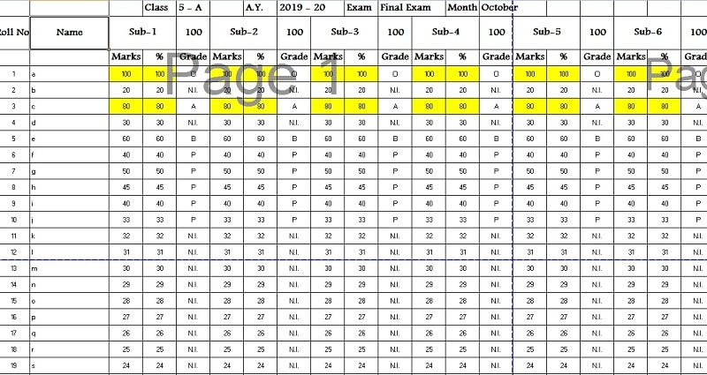
Class Result

Slide 39
John Received the
Score any one from these..
Score: 25
100
Score: 25
25
Score: 25
50

Slide 40
Conclusion
Summarization of the report always be an reliable and accurate. Then only we know the students’ performance correctly. Reporting of the findings must be reliable at any point of the assessment report. Completion of the reporting works shows that the effective teaching as well as learning.

Slide 41


